Slide 1
Decision Making Statements
if statements if-else statements Nested if statements Multi-way if-elif-else statements
Notes:
ITC- List reverse s55 method (1-6-21) , IT-B list slide 83 50(31-5-21), CSIT-B – List slide 13 (31-5-21), IT-A: insert method 42slide 2-6-21) , CSIT-A: Loop ended list to start

Slide 2
if statements
syntax:
if condition:
statements
Note:(a)The statements must be indented at least one right space of the if statement.

Slide 3
(b) In case there is more than one statements after the if condition, then each statements must be indented using the same number of spaces to avoid indentation errors.
Examples:
a = 33 b = 200 if b > a: print("b is greater than a")
Wrong practice----
a = 33 b = 200 if b > a: print("b is greater than a")
Example2-
Error: Indentation Error
i = 10
if (i > 15):
print ("10 is less than 15")
print ("I am Not in if")
Output: I am Not in if

Slide 4
If-else statements
syntax:
if condition:
statements
else:
statements

Slide 5
Example1-
# python program to illustrate If else statement i = 20; if (i < 15): print ("i is smaller than 15") print ("i'm in if Block") else: print ("i is greater than 15") print ("i'm in else Block") print ("i'm not in if and not in else Block")
Output:
i is greater than 15
i'm in else Block
i'm not in if and not in else Block

Slide 6
Examples
Example2—
Val = int(input(“Enter any number: ”))
if(Val > 5):
print(“Cube of the number is: ”, Val ** 3)
else:
print(“Square of the number is: ”, Val ** 2)
Example3---
Find greatest of two numbers:
Num1= int(input(“Enter the First Number: ”))
Num2=int(input(“Enter the Second Number: ”))
if Num1 > Num2:
print( Num1, “is greater than”, Num2)
else:
print( Num2, “is greater than”, Num1)

Slide 7
Question
Write a program to test whether a number is divisible by 5 and 10 or by 5 or 10. Ask user to enter the number.

Slide 8
Solution
num = int(input(“Enter the number: ”))
print(“Entered Number is: ”, num)
if(num % 10 ==0):
print(num, “is divisible by both 5 and 10”)
if(num % 5 == 0 or num % 10 ==0):
print(num, “is divisible by 5 or10”)
else:
print(num, “is not divisible by either 5 or 10”)

Slide 9
Short Hand If
If you have only one statement to execute, you can put it on the same line as the if statement.
Example
One line if statement:
if a > b: print("a is greater than b")
Short Hand If ... Else
If you have only one statement to execute, one for if, and one for else, you can put it all on the same line:
Example
One line if else statement:
a = 2
b = 330
if a > b: print("a is greater than b")
else: print("b is greater than a") can be substituted as
print(“a is greater than b”) if a>b else print(“b is greater than a”)

Slide 10
NOTE: Python does not support Conditional Operator ( _?_ :_ ) But Python support Conditional Expression
Example—
a = 2
b = 330
if a > b:
print("a")
else:
print("b")
This can be written in the form of Conditional Expression as:
a = 2
b = 330
print("a") if a > b else print("b")
You can also have multiple else statements on the same line:
Example
One line if else statement, with 3 conditions:
a = 330
b = 630
print("a") if a > b else print("=") if a == b else print("b")

Slide 11
Nested If - Else
syntax:
if (condition1):
# Executes when condition1 is true
if (condition2):
# Executes when condition2 is true
# inner if Block is end here
# outer if Block is end here

Slide 12
Nested If else Example
i = 10
if (i == 10):
# First if statement
if (i < 15):
print ("i is smaller than 15")
# Nested - if statement
# Will only be executed if statement above
# it is true
if (i < 12):
print ("i is smaller than 12 too")
else:
print ("i is greater than 15")
Output:
i is smaller than 15
i is smaller than 12 too

Slide 13
if-elif-else statements
syntax:
if (condition):
statement
elif (condition):
statement
.
.
else:
statement

Slide 14
# Python program to illustrate if-elif-else ladder
i = 20
if (i == 10):
print ("i is 10")
elif (i == 15):
print ("i is 15")
elif (i == 20):
print ("i is 20")
else:
print ("i is not present")
Output:
i is 20

Slide 15
Example Program
Q1. Write a program to prompt a user to enter a day of the week. If the entered day of the week is between 1 and 7 then display the respective name of the day.

Slide 16
Solution
Day = int(input(“Enter the day of the week”))
if day == 1:
print(“Its Monday”)
if day == 2:
print(“Its Tuesday”)
if day == 3:
print(“Its Wednesday”)
if day == 4:
print(“Its Thursday”)
if day == 5:
print(“Its Friday”)
if day == 6:
print(“Its Saturday”)
if day == 7:
print(“Its Sunday”)
else:
print(“Sorry!!! Week contains only 7 days”)

Slide 17
Example to understand if-elif-else statements
if per > 90:
print(“Distinction”)
else:
if per > = 80:
print(“First Class”)
else:
if per > = 70:
print(“Second Class”)
else:
if per > = 60:
print(“Pass”)
else:
print(“Fail”)
Convert this program by using if elif else

Slide 18
Using if elif else
if per > 90:
print(“Distinction”)
elif per > = 80:
print(“First Class”)
elif per > = 70:
print(“Second Class”)
elif per > = 60:
print(“Pass”)
else:
print(“Fail”)

Slide 19
Practice a Program to find the median of three numbers

Slide 20
if x <= y:
if x >= z:
mymedian = x
# Your code below this line
elif y <= z:
mymedian = y
else: mymedian = z
else:
if x < z: mymedian = x
elif y > z:
mymedian = y
else:
mymedian = z

Slide 21
Practice Problem
Q. Write a python program to check whether or not a given number is less than 50. If the number is less than 50, then check whether the number is greater than 25 or not. If the number is less than 25, then check whether the number is even or odd.

Slide 22
Solution
num = int(input("Enter the number: "))
if(num < 50):
print("number is less than 50")
if(num>25):
print("number is greater than 25")
else:
print("number is less than 25")
if(num % 2==0):
print("number is even")
else:
print("number is odd")
else:
print("number is greater than 50")

Slide 23
Understanding Loops in Python
Before using Loops Lets understand the function used in looping
THE range( ) FUNCTION
There is a inbuilt function in Python called range( ) which is used to generate a list of integers.
Syntax--- range(start, stop, step)
Here Start is the beginning of the list
Stop is the end of the list but not included
Step is the size of jump in the sequence. This is optional. The default Step Size is 1

Slide 24
Generating list of integers using Range
Example—
>>> list(range(1, 6))
Output is – [1, 2, 3, 4, 5]
>>>list(range(1, 20, 2))
Output is – [1, 3, 5, 7, 9, 11, 13, 15, 17, 19]

Slide 25
Guess the outputs
What will be range of values for these calls if we pass to list function after this call.
Q1. >>> range(5)
Q2. >>> range(1,5)
Q3. >>> range(1,10,2)
Q4. >>> range(5,0,-1)
Q5. >>> range(5,0,-2)
Q6. >>> range(-4,4)
Q7. >>> range(-4,4,2)
Q8. >>> range(0,1)

Slide 26
Answers
Q1. [0,1,2,3,4]
Q2. [1,2,3,4]
Q3. [1,3,5,7,9]
Q4. [5,4,3,2,1]
Q5. [5,3,1]
Q6. [-4,-3,-2,-1,0,1,2,3]
Q7. [-4,-2,0,2]
Q8. [0]

Slide 27
Looping
If a Message is to written 50 times then we may need to write print 50 times if we don’t have loops.
This can be done more easily using loop in Python.
Loops are used to repeat the same code multiple times.
Python provides two types of loop statements:
while
for
The while loop is a condition controlled loop. It is controlled by true or false conditions.
The for loop is a count controlled loop which repeat for a specific number of times.

Slide 28
THE for LOOP
A for loop is used for iterating over a sequence (that is either a list, a tuple, a dictionary, a set, or a string). Currently Focus on strings
Syntax—
for var in sequences:
statements

Slide 29
Example1. —
for i in range(1,6):
print(i)
print("End of the program")
Output—
1
2
3
4
5
End of the program

Slide 30
Example2. —
for i in range(1,6):
print(i, end = “ ”)
print("End of the program")
Output—
1 2 3 4 5
End of the program

Slide 31
Question to do
Write a program in Python to print the numbers from 1 to 10 in reverse order (Show output in single line)
.

Slide 32
Solution
print("Numbers from 1 to 10 in reverse Order: ")
for i in range( 10, 0, -1):
print( i, end = " ")
print("\nEnd of th program")

Slide 33
Problem
Write a program in Python to print even numbers from 0 to 10 and find their sum.

Slide 34
Solution
sum = 0
print("Even numbers from 0 to 10 are as follows: ")
for i in range(0,11,1):
if i % 2==0:
print(i)
sum = sum + i
print("Sum of Even numbers from 0 to 10 is = ", sum)

Slide 35
Write a program in Python to print squares of the first five natural numbers.

Slide 36
for i in range(1, 6):
square = i * i
print( "Square of ", i, "is: ", square)
print("\nEnd of the program")

Slide 37
Write a program in Python to calculate the sum of numbers from 1 to 20 which are not divisible by 2, 3 or 5.

Slide 38
sum = 0
print("numbers from 1 to 20 which are not divisible by 2, 3 or 5 ")
for i in range(1, 20):
if i % 2==0 or i % 3==0 or i % 5==0:
print(" ")
else:
print(i)
sum = sum + i
print("Sum of Even numbers from 1 to 20 which are not divisible by 2, 3 or is = ", sum)

Slide 39
Print each fruit in a fruit list:
fruits = ["apple", "banana", "cherry"]
for x in fruits: print(x)
Output—
apple
banana
cherry

Slide 40
Loop through the letters in the word
"banana":
for x in "banana": print(x)
Output—
b
a
n
a
n
a

Slide 41
THE break STATEMENT
The Keyword break allows a programmer to terminate a loop.
When the break statement is encountered inside a loop, the loop is immediately terminated and the program control automatically goes to the first statement following the loop.

Slide 42
Example—
print("The numbers from 1 to 10 are as follows: ")
for i in range(1, 100, 1):
if i == 11:
break
else:
print(i, end= " ")
Output:
The numbers from 1 to 10 are as follows:
1 2 3 4 5 6 7 8 9 10

Slide 43
Break Example
Exit the loop when x is "banana":
fruits = ["apple", "banana", "cherry"] for x in fruits: print(x) if x == "banana": break
Output—
apple
banana

Slide 44
THE continue STATEMENT
When continue is encountered within a loop, the remaining statements within the body are skipped but the loop condition is checked to see if the loop should continue or exit.
Example—
for i in range(1,11,1):
if i == 5:
continue
print(i, end = " ")
Output—
1 2 3 4 6 7 8 9 10

Slide 45
Example Do not print banana:
fruits = ["apple", "banana", "cherry"] for x in fruits: if x == "banana": continue print(x)
Output—
apple
cherry

Slide 46
Else in For Loop
The else keyword in a for loop specifies a block of code to be executed when the loop is finished:
Example
Print all numbers from 0 to 5, and print a message when the loop has ended:
for x in range(6): print(x) else: print("Finally finished!")
Output—
0
1
2
3
4
5
Finally finished!

Slide 47
Nested Loops
A nested loop is a loop inside a loop.
The "inner loop" will be executed one time for each iteration of the "outer loop":
Example
Print each adjective for every fruit:
adj = ["red", "big", "tasty"] fruits = ["apple", "banana", "cherry"] for x in adj: for y in fruits: print(x, y)

Slide 48
Output—
red apple
red banana
red cherry
big apple
big banana
big cherry
tasty apple
tasty banana
tasty cherry

Slide 49
USE of pass
Pass Statement: We use pass statement to write empty loops. Pass is also used for empty control statement, function and classes.
for letter in ‘pythonprogramming':
pass
print ("Last Letter : ", letter)
Ouput:
??

Slide 50
Find the output—
for num1 in range(3):
for num2 in range(10, 14):
print(num1, ",", num2)

Slide 51
Output—
0 , 10
0 , 11
0 , 12
0 , 13
1 , 10
1 , 11
1 , 12
1 , 13
2 , 10
2 , 11
2 , 12
2 , 13

Slide 52
While Loop
The while loop is a loop control statements in Python.
Frequently used in programming for repeated execution of statements in a loop.
It executes a sequence of statements repeatedly as long as a condition remains true.

Slide 53
While loop
Syntax—
while test_condition:
Statements
Note—
while is a keyword
Test condition is a Boolean expression.
Colon(:) must follow the test condition.

Slide 54
Example
count = 0
while (count < 9):
print (“The count is:”, count)
count = count + 1
print ("Good bye!")
When the above code is executed, it produces the following result −
The count is: 0
The count is: 1
The count is: 2
The count is: 3
The count is: 4
The count is: 5
The count is: 6
The count is: 7
The count is: 8
Good bye!

Slide 55
Example---
count = 0
while (count < 3):
count = count + 1
print("While Loop is running")
Output:
While Loop is running
While Loop is running
While Loop is running

Slide 56
Using else statement with while loops
While loop executes the block until a condition is false.
When the condition becomes false, the statement immediately after the loop is executed.
The else clause is only executed when your while condition becomes false.
while condition:
statements
else:
statements

Slide 57
Example—
count = 0
while (count < 3):
count = count + 1
print("Hello Python")
else:
print("In Else Block")
Output:
Hello Python
Hello Python
Hello Python
In Else Block

Slide 58
Example---
i = 1
while i <= 10:
print(i)
i += 1
else:
print(“Loop ended, i = ”, i)
Output---
1
2
3
4
5
6
7
8
9
10
Loop ended, i = 11

Slide 59
Infinite Loops
while True:
print("hello")
-------------------------
num = 1
while num<5:
print(num)

Slide 60
Nested while loop in Python
When a while loop is present inside another while loop then it is called nested while loop. Lets take an example to understand this concept.
i = 1
j = 5
while i < 4:
while j < 8:
print(i, ",", j)
j = j + 1
i = i + 1
Output:
1 , 5
2 , 6
3 , 7

Slide 61
Find the Output
n = 5
while n > 0:
n - = 1
if n == 2:
break
print(n)
print('Loop ended.')

Slide 62
Output---
4 3
Loop ended.

Slide 63
Interpret the output
for num1 in range(3):
for num2 in range(10, 14):
print(num1, ",", num2)

Slide 64
Output—
0 , 10
0 , 11
0 , 12
0 , 13
1 , 10
1 , 11
1 , 12
1 , 13
2 , 10
2 , 11
2 , 12
2 , 13

Slide 65
Interpret the output
for num in range(10,20):
for i in range(2,num):
if num%i == 0:
j=num/i
print ("%d equals %d * %d" % (num,i,j))
break
else:
print (num, "is a prime number")

Slide 66
Output—
10 equals 2 * 5
11 is a prime number
12 equals 2 * 6
13 is a prime number
14 equals 2 * 7
15 equals 3 * 5
16 equals 2 * 8
17 is a prime number
18 equals 2 * 9
19 is a prime number

Slide 67
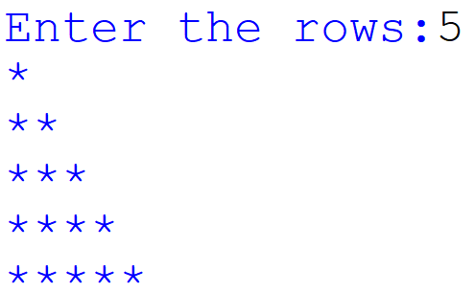
Write a Python Program for the following Pattern—

Slide 68
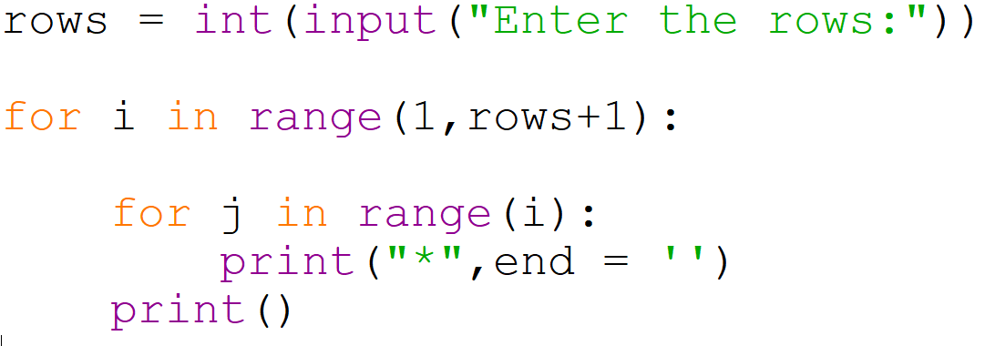
The Python Program for the Pattern

Slide 69
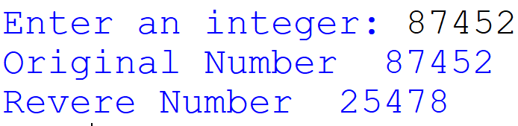
Write a Python to enter an integer number and reverse it

Slide 70
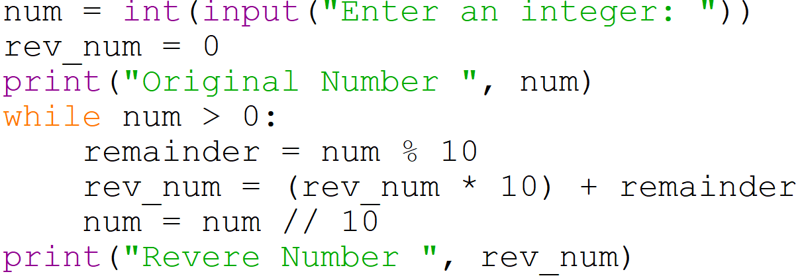
The Python Program for the above problem

Slide 71
expression evaluation and float representation
In Python actions are performed in two forms :
Expression evaluation, b. Statement execution.
2. The key difference between these two forms is that expression evaluation
returns a value whereas statement execution does not return any value.
3. A Python program contains one or more statements. A statement contains zero or more expressions.
4. Python executes a statement by evaluating its expressions to values one by one.
5. Python evaluates an expression by evaluating the sub-expressions and substituting their values.
6. An expression is not always a mathematical expression in Python. A
value by itself is a simple expression, and so is a variable.
7. In the given example, we assigned a value “Hello Python” to the variable program. Now, when we type only program, we get the output ‘Hello Python’. This is the term we typed when we assigned a value to the variable. When we use a print statement with program it gives the value of the variable i.e., the value after removing quotes.

Slide 72
>>> float(0.1)
0.1
>>> float('1.25’)
1.25
>>> format(0.1, '.20f') '0.10000000000000000555’
print(float(248))
248.0

Slide 73
Float is a function or reusable code in the Python programming language that converts values into floating point numbers. Floating point numbers are decimal values or fractional numbers like 133.5, 2897.11, and 3571.213, whereas real numbers like 56, 2, and 33 are called integers. Using the float function in Python on a specific value will convert it into a decimal number or fractional form. In simple terms, the purpose of the float function in Python is to convert real numbers or integers into floating point numbers.
Here is an example to help you better understand a float() function.
If you type:
x = float(56)
print(x)
And run the program, the value of x will be 56.0.

